Slide 1

Video playing
Man in VR interacting with video

Slide 2
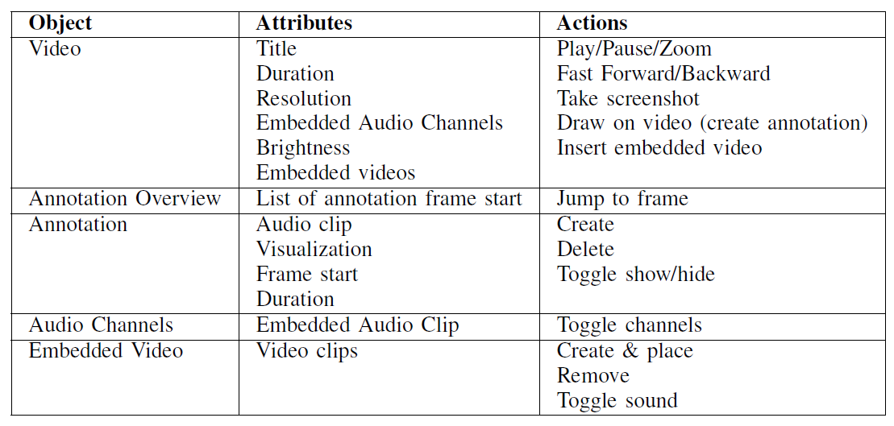
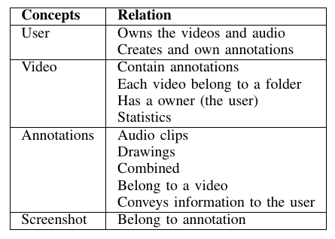


Slide 3
